Slide 1



Who did that?!?
Auditing data in RFMS with Enterprise

Slide 2
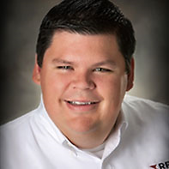
Your Presenter today
RJ Petersen
Director of Implementation and Training
800-701-7367 x 3525 office
rpetersen@rfms.com
www.rfms.com
Business Management Solutions Flooring Specific Software
Notes:
MY NAME IS CINDY AND I’LL BE THE PRESENTER FOR TODAY’S EVENT
I AM A MEMBER OF THE TRAINING TEAM HERE WITH RFMS
AND I’VE BEEN LEARNING / USING / OR TRAINING RFMS FOR 28 YEARS NOW

Slide 3
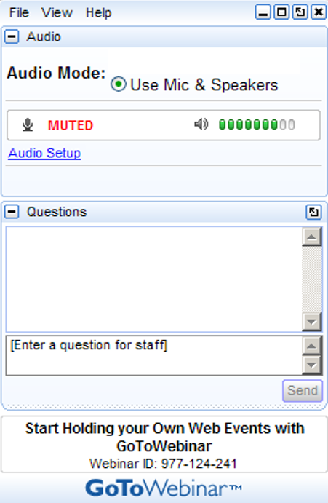
HOW TO PARTICIPATE
ORANGE BOX TO HIDE PANEL
DURING THE WEBINAR.
TYPE YOUR
QUESTION HERE AND HIT SEND
TYPE YOUR QUESTIONS & HIT SEND
Raise HAND TO BE UNMUTED
Notes:
HERE’S HOW TO PARTICIPATE IN OUR WEBINAR TODAY
WHEN YOU LOGGED IN, / TO THE RIGHT OF YOUR SCREEN / YOU SHOULD SEE YOUR GOTOMEETING CONTROL PANEL
CLICK
TAP THE ORANGE TAB TO MINIMIZE THE DISPLAY PANEL
CLICK
DURING THE PRESENTATION TYPE YOUR QUESTIONS IN THE BOX AND HIT SEND
THERE ARE OTHER TRAINERS ON HAND THAT WILL BE HAPPY TO ANSWER THOSE FOR YOU
CLICK
IF YOU WOULD LIKE TO VERBALLY ASK QUESTIONS AT THE END / TAP THE HAND TO BE UNMUTED
WE ARE RECORDING THIS SESSION / AND NORMALLY / WITHIN 24 HOURS / ALL ATTENDEES WILL RECEIVE AN EMAIL WITH A LINK TO THAT RECORDING
CLICK

Slide 4




NEED HELP?
INTENSIVE!
Email help@rfms.com your
favorite
trainer!
BOOTCAMP
Schedule is on
RFMS.com
Sign up early and
Save!
LIVE
WEBINARS
eLEARNING
Tuesdays &
Thursdays
2:00pm CST
Free!
Just a click
away at
RFMS.com!
Notes:
AS ALWAYS
NEVER HESITATE TO EMAIL YOUR FAVORITE TRAINER WITH QUESTIONS OR DIRECTION - CLICK
WE’VE STILL GOT SEVERAL WEBINARS PLANNED THIS YEAR / SO BE SURE TO VISIT OUR WEBSITE FOR INFORMATION ON THOSE - CLICK
THE BOOT CAMP SCHEDULE IS OUT / AND THERE IS CURRENTLY AN EARLY BIRD SPECIAL / SO YOU WILL WANT TO LOOK INTO THAT
ALSO WANT TO MENTION THAT THERE HAVE BEEN SOME ADDITIONS TO THE SCHEDULE IN ORLANDO AND I BELIEVE SEATTLE
IF YOU ARE CLOSE TO EITHER OF THOSE LOCATIONS / YOU WILL WANT TO GO LOOK AT THE SCHEDULE - CLICK
AND ELEARNING
AT RFMS.COM / DROP THE TRAINING TAB AND SELECT ELEARNING TO FIND TRAINERS AND THEIR AVAILABLE TIME

Slide 5
What is Enterprise Manager?

Slide 6


What is Enterprise in RFMS?
A Car Rental Company
A Spaceship from a popular TV show

Slide 7
Have you ever wanted to….
Add a level of sophistication to your security in RFMS?
Eliminate passwords?
Know who did something in RFMS and know what they changed?
Lock RFMS to make it easier to install updates?

Slide 8
Enterprise Manager will do that and more!
Enterprise for RFMS is an add on module available for purchase
Uses Windows authentication for RFMS access (instead of passwords in RFMS)
Create events to audit your system for changes/inserts/deletes to data in RFMS

Slide 9

Passwords vs. Roles

Slide 10

Password Levels in RFMS
Level 1 – Owner
Level 2 - Accounting
Level 3 – Sales Manager
Level 4 - Warehouse
Level 5 - Sales
You can only go down the pyramid, not up

Slide 11

Roles in RFMS
RFMS Admin Role - Owner
Void
Order
Enter
Payable
Add Order
Jobcost
Unjobcost
Enter PO
Receive
Inventory
General
Ledger
Check
Writing
Access
Enterprise
Adjust Inventory
Edit Order
Post Payment
Edit Product

Slide 12
Roles in RFMS
Accounting/Bookkeeper
Void
Order
Enter
Payable
Add Order
Jobcost
Unjobcost
Enter PO
Receive
Inventory
General
Ledger
Check
Writing
Access
Enterprise
Adjust Inventory
Edit Order
Post Payment
Edit Product

Slide 13
Roles in RFMS
Warehouse Manager
Void
Order
Enter
Payable
Add Order
Jobcost
Unjobcost
Enter PO
Receive
Inventory
General
Ledger
Check
Writing
Access
Enterprise
Adjust Inventory
Edit Order
Post Payment
Edit Product

Slide 14
Roles in RFMS
Sales Manager
Void
Order
Enter
Payable
Add Order
Jobcost
Unjobcost
Enter PO
Receive
Inventory
General
Ledger
Check
Writing
Access
Enterprise
Adjust Inventory
Edit Order
Post Payment
Edit Product

Slide 15
Roles in RFMS
Sales Reps
Void
Order
Enter
Payable
Add Order
Jobcost
Unjobcost
Enter PO
Receive
Inventory
General
Ledger
Check
Writing
Access
Enterprise
Adjust Inventory
Edit Order
Post Payment
Edit Product

Slide 16

Managing Users, Groups and Roles in Enterprise

Slide 17
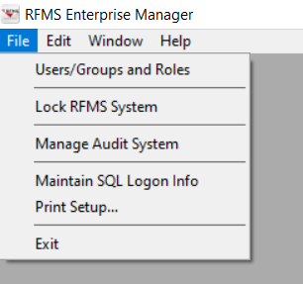
Users/
Groups and Roles

Slide 18
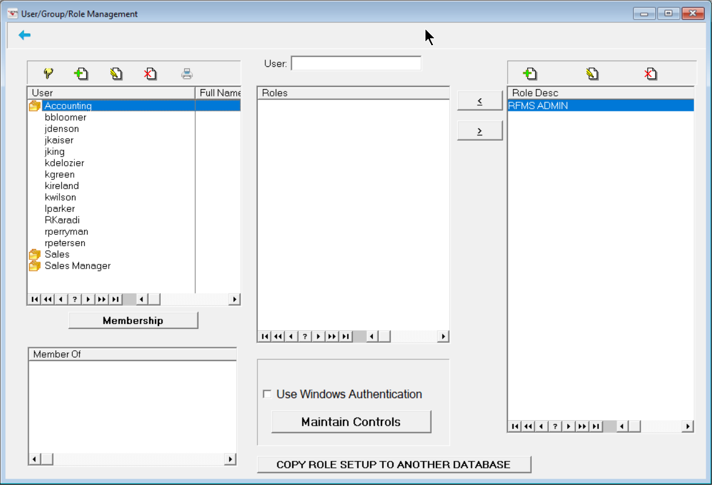
Assign Roles to selected user/group
1. Add Roles
2. Add Users and Groups
4. Turn on Enterprise

Slide 19
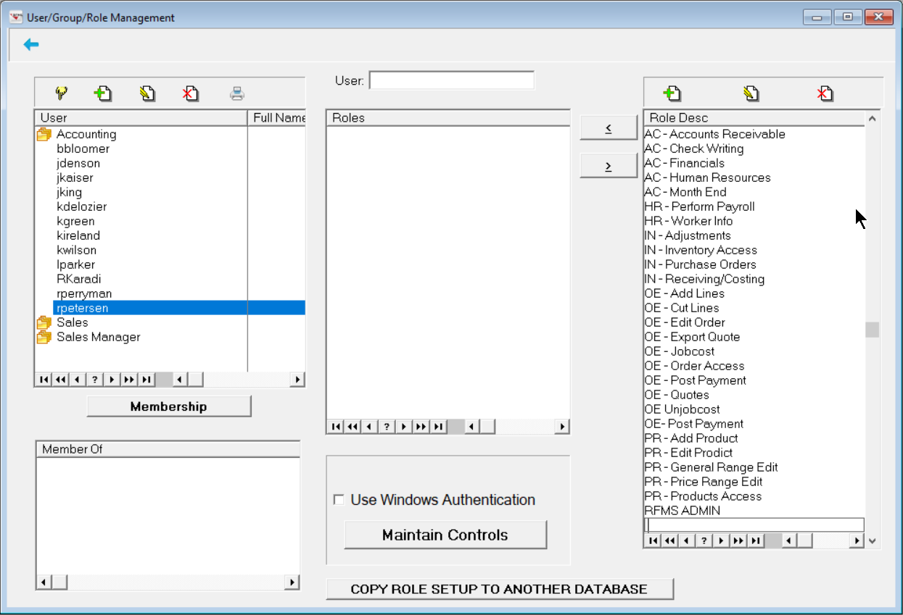
AC – Check Writing
Adding Roles

Slide 20
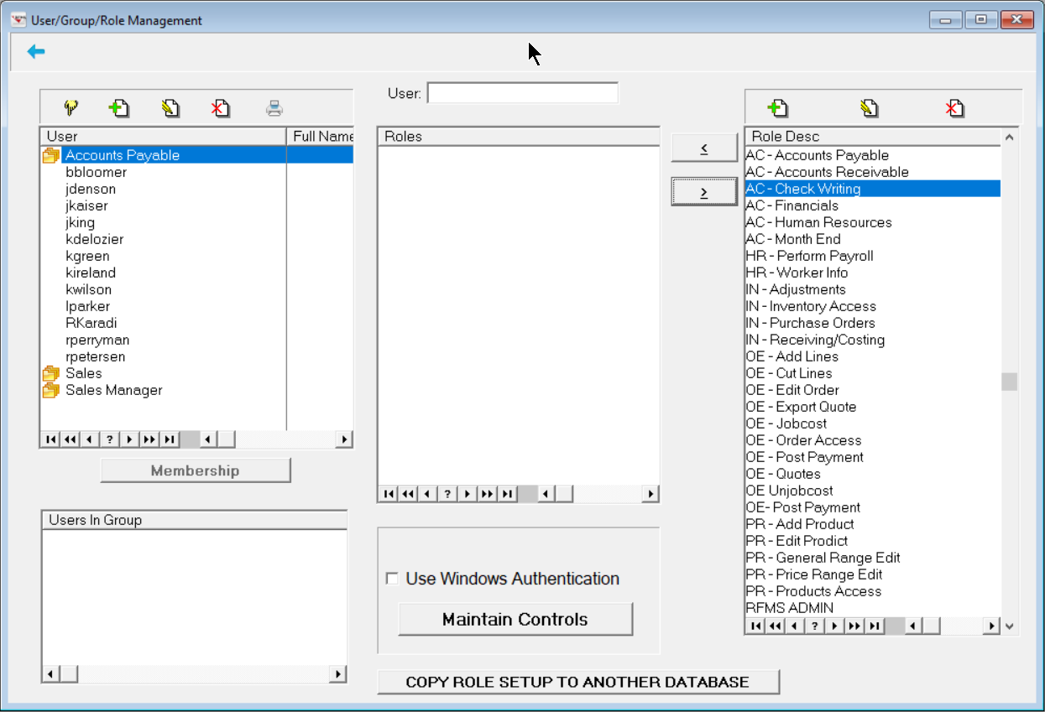
Assigning roles to users/groups

Slide 21
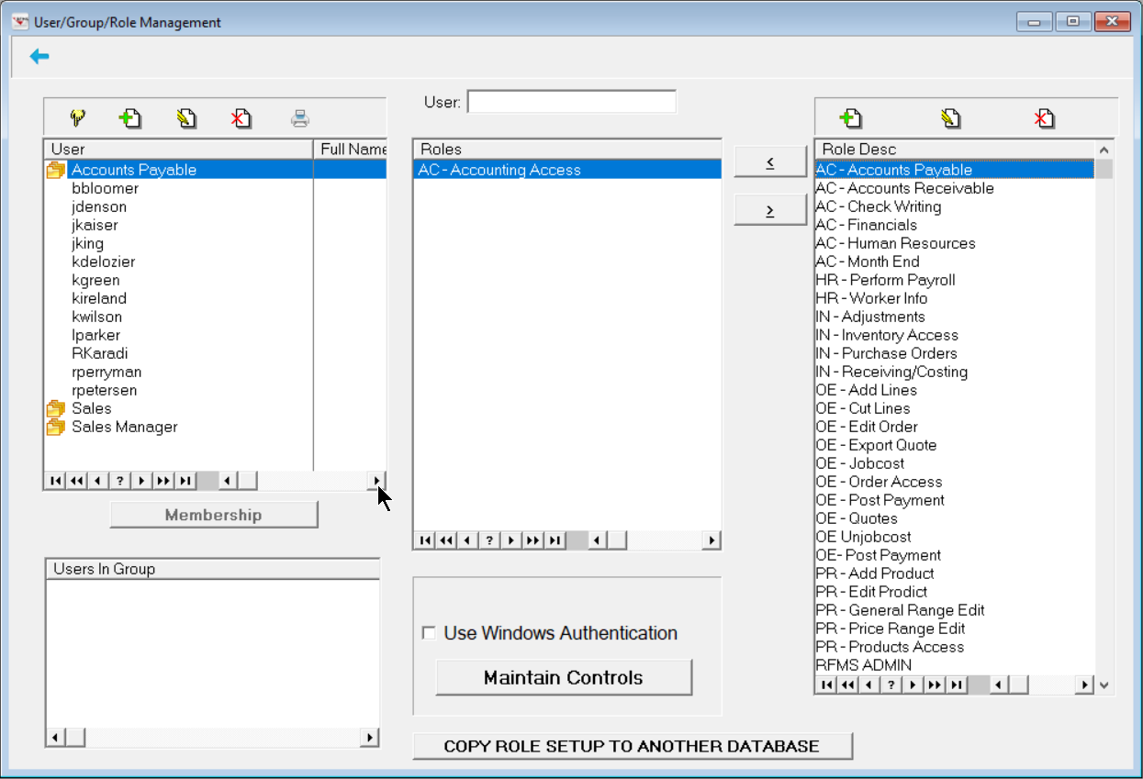
Assigning roles to users/groups

Slide 22
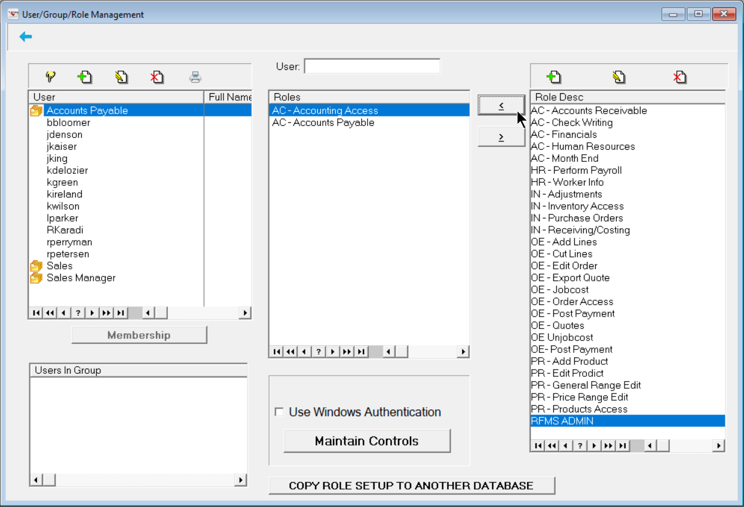
Assigning roles to users/groups

Slide 23
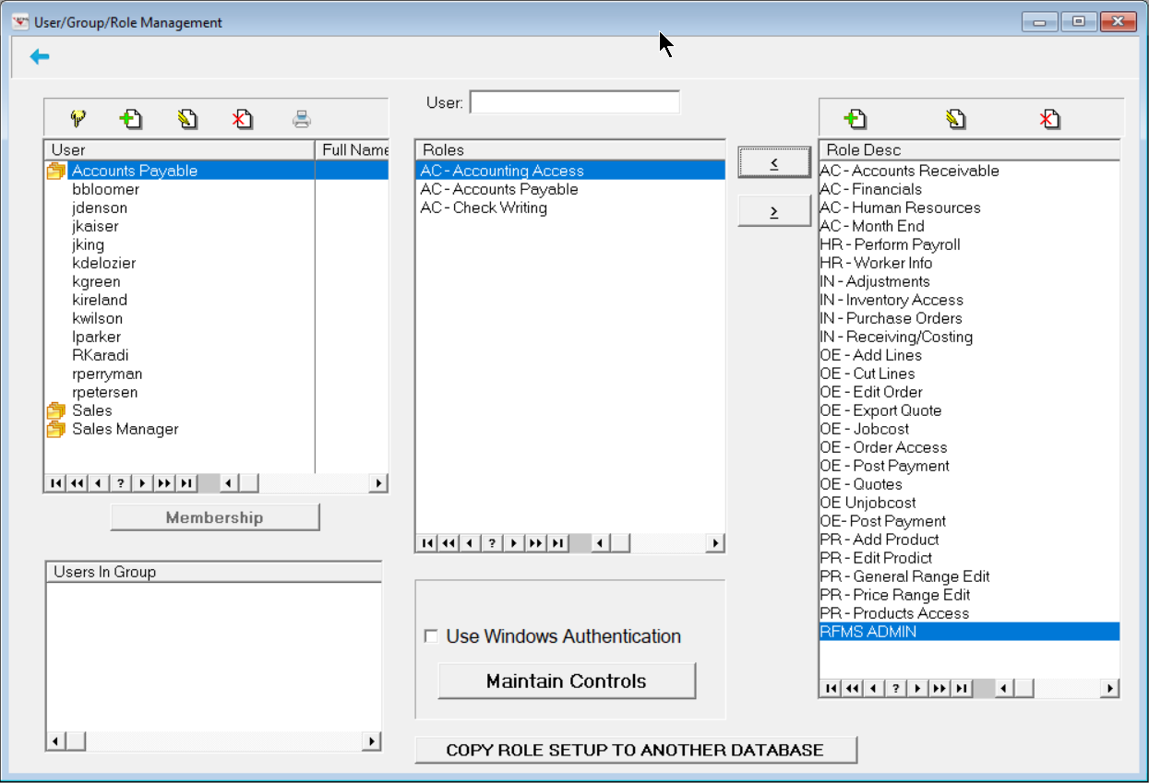
Assigning roles to users/groups

Slide 24
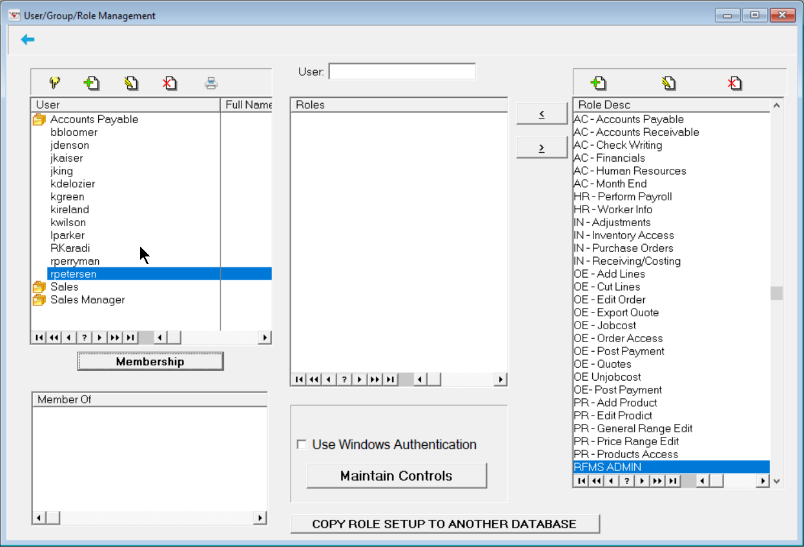
Assigning groups to users

Slide 25
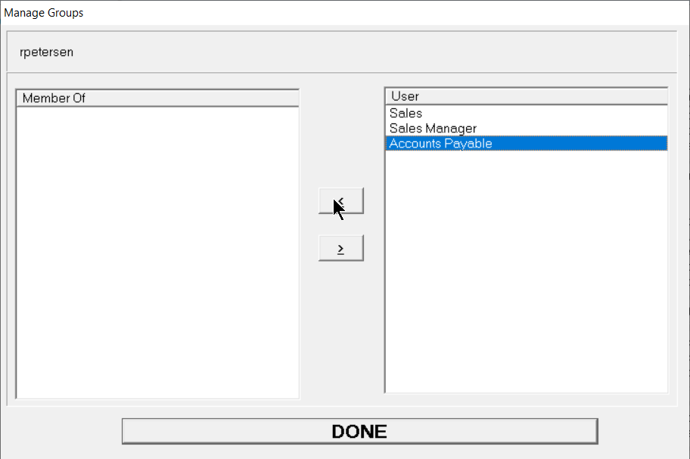
Assigning groups to users

Slide 26
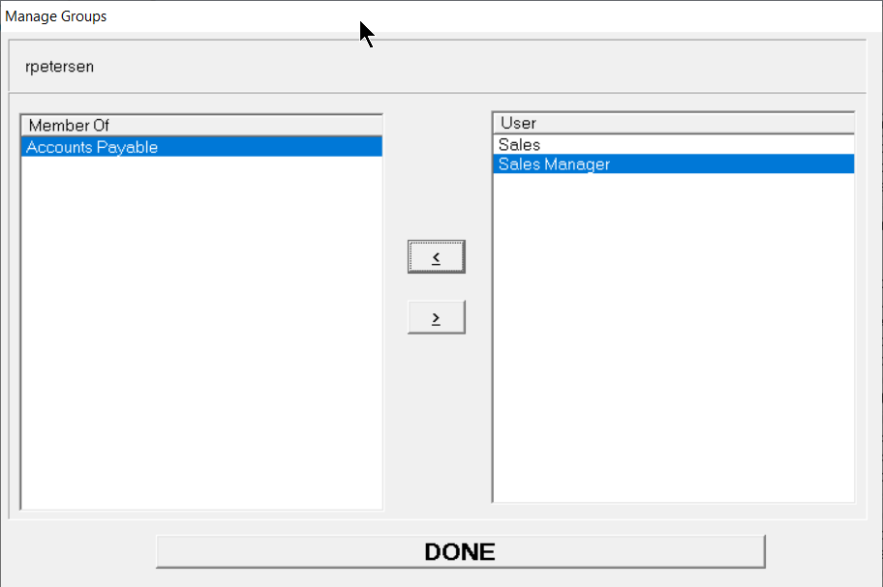
Assigning groups to users

Slide 27
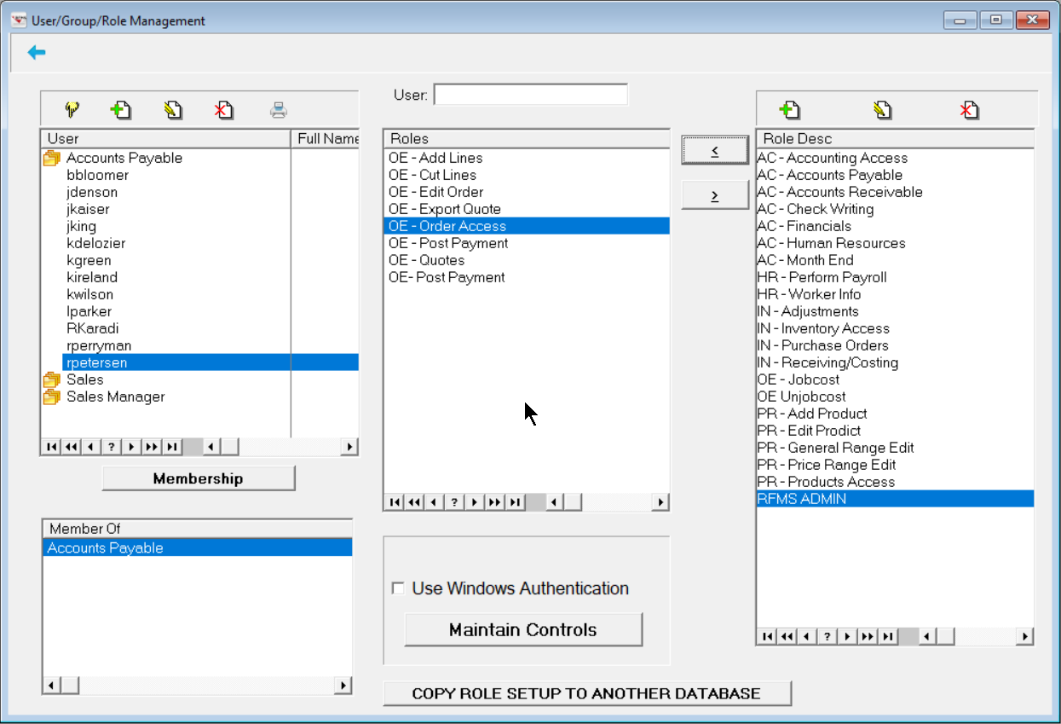
Users/groups and roles

Slide 28

One more step
After you have created Roles you must link the role to the function(s) in RFMS.
This is done by entering Password Mode and selecting the Function and selecting the Role

Slide 29
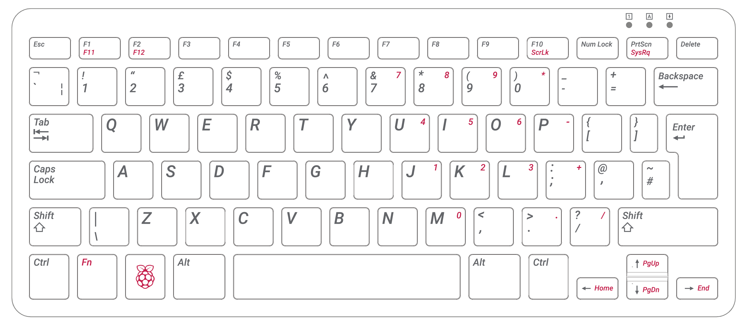
Entering Password Mode

Slide 30
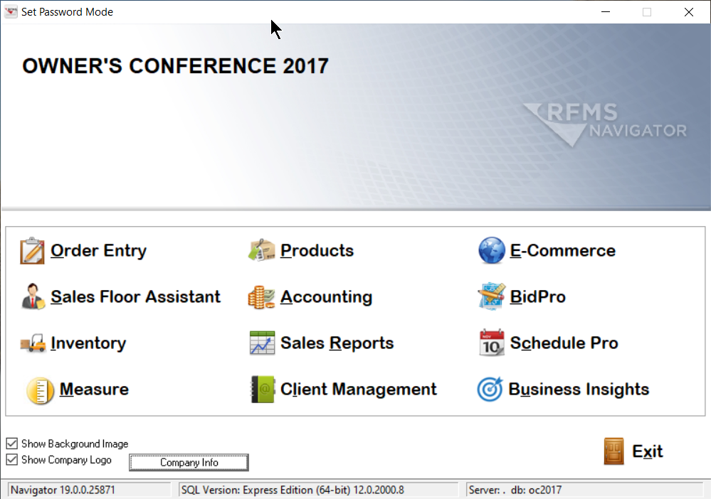
Setting roles in rfms

Slide 31
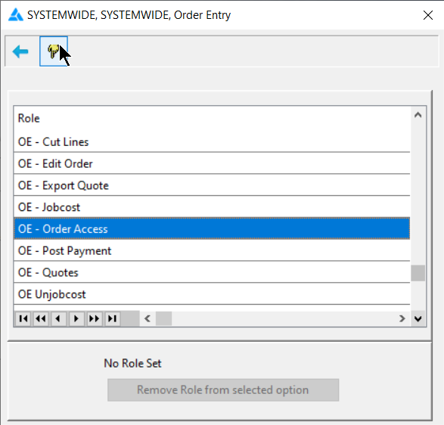
Setting roles in rfms

Slide 32
Setting roles in rfms

Slide 33
Exiting Password Mode

Slide 34
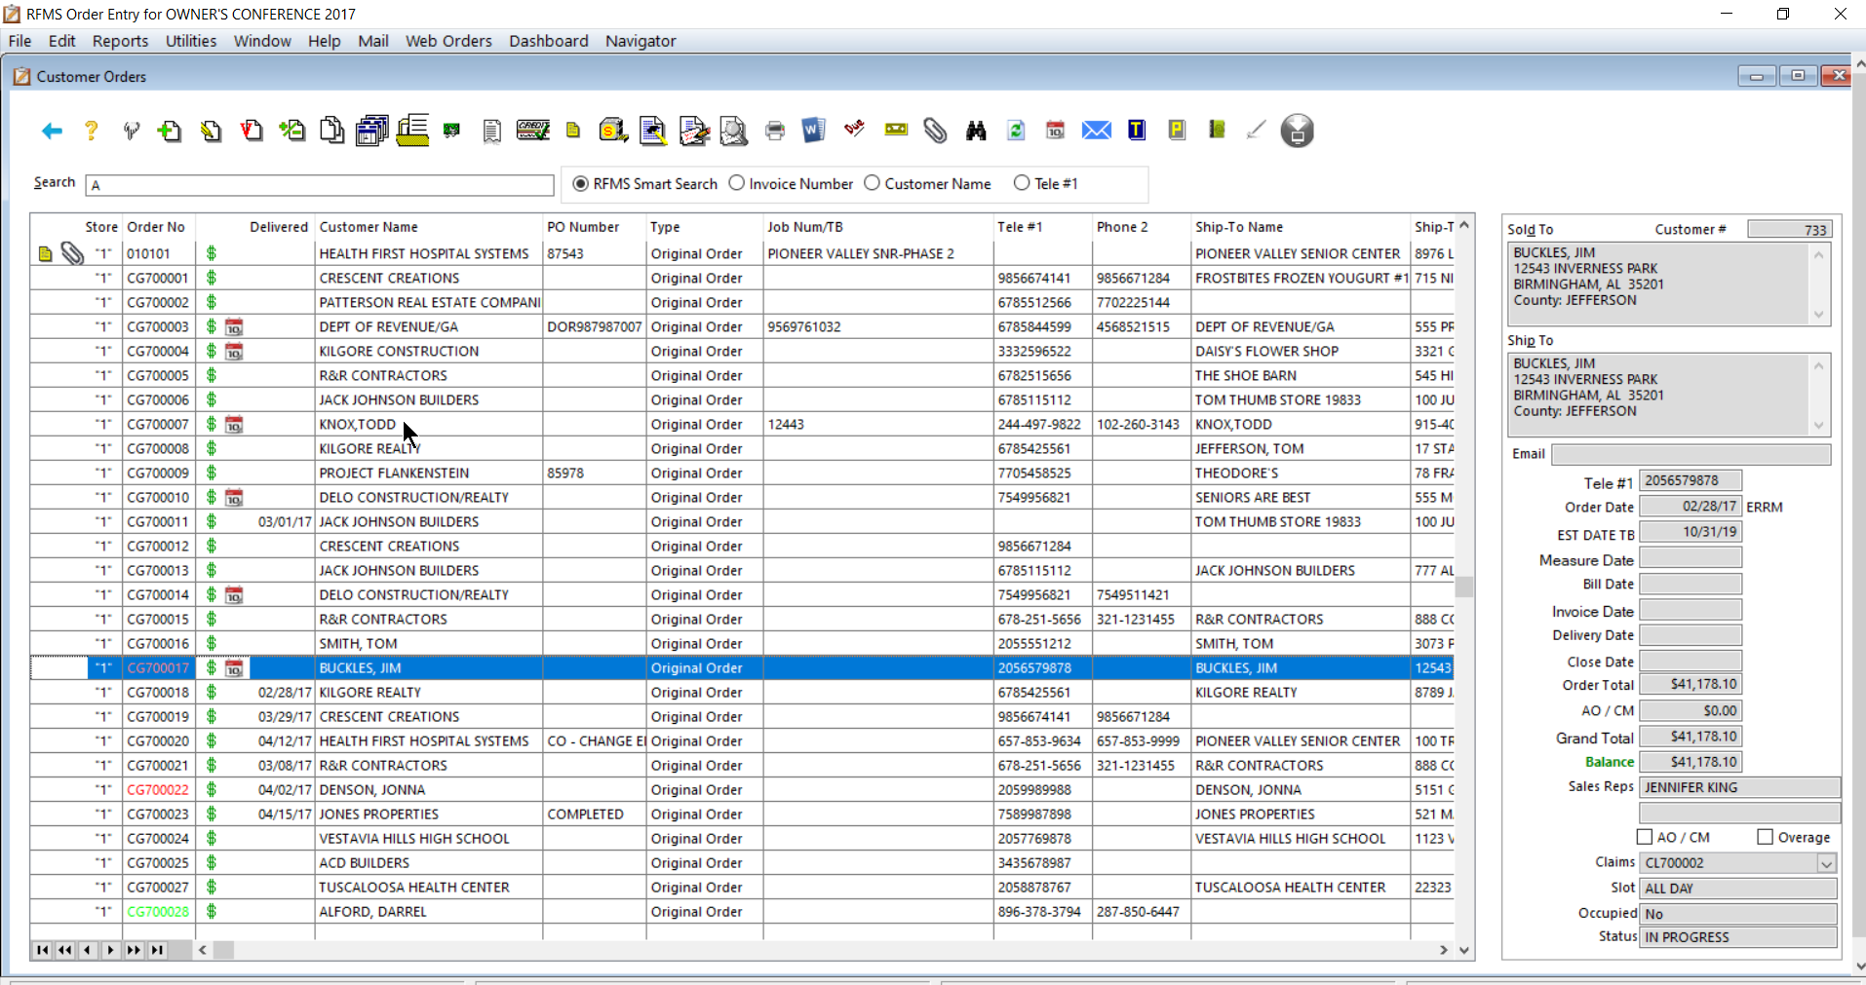
Setting roles in rfms

Slide 35
Entering Password Mode

Slide 36
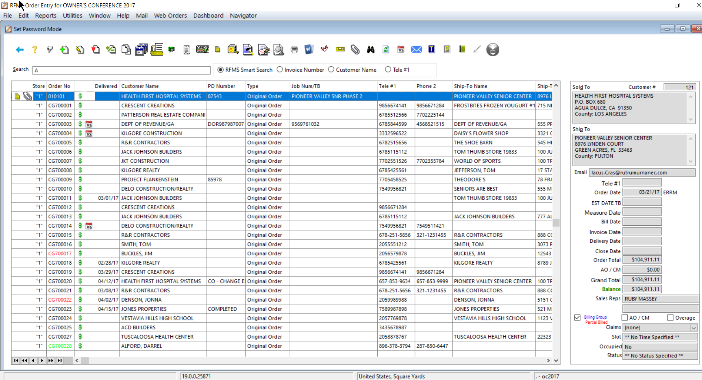
Setting roles in rfms

Slide 37
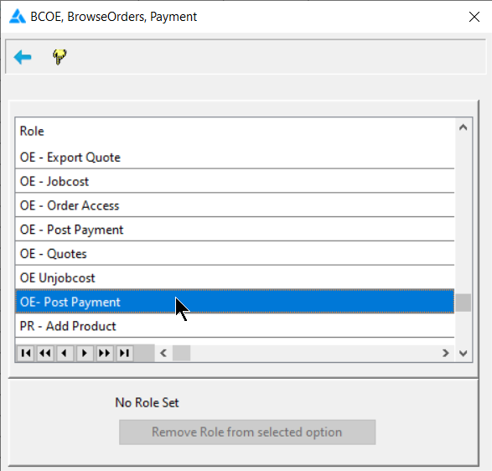
Setting roles in rfms

Slide 38
Setting roles in rfms

Slide 39
Exiting Password Mode

Slide 40

LOCK RFMS System

Slide 41
Lock RFMS System

Slide 42


Message sent to users
Upon “Locking” RFMS, this message is displayed to all active users

Slide 43
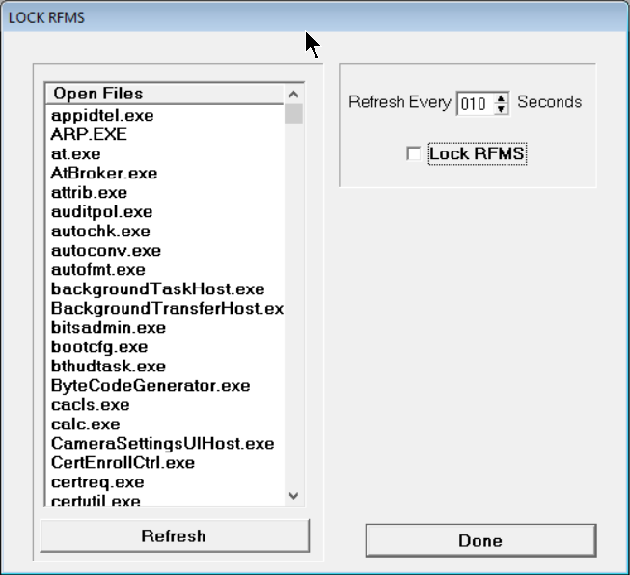
Enterprise view
Settings
In use functions

Slide 44

Manage Audit System

Slide 45
Manage Audit System

Slide 46
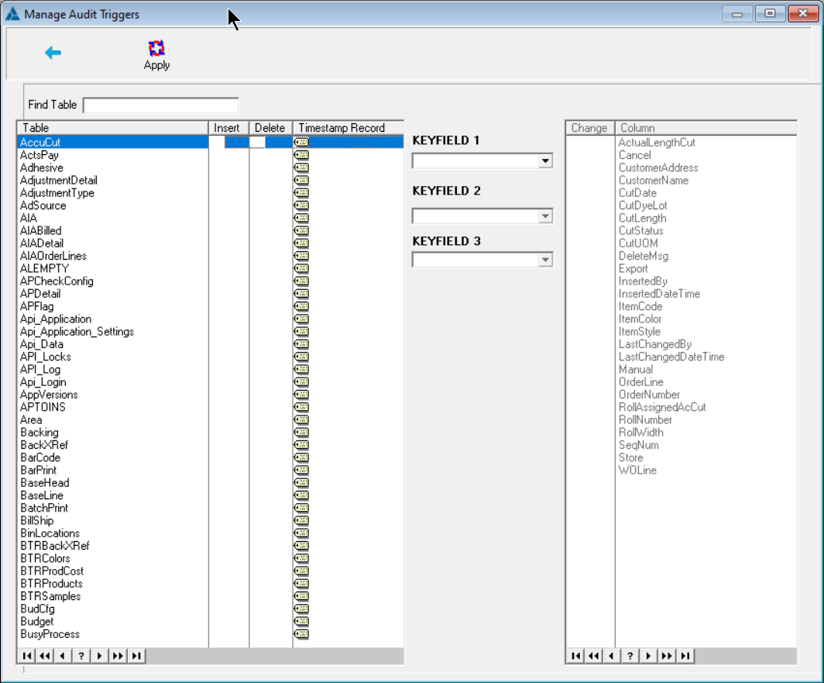
Keyfields for Changes
Table Names
Insert/Delete/
Timestamp
Changes to Audit
Managing audit Triggers

Slide 47
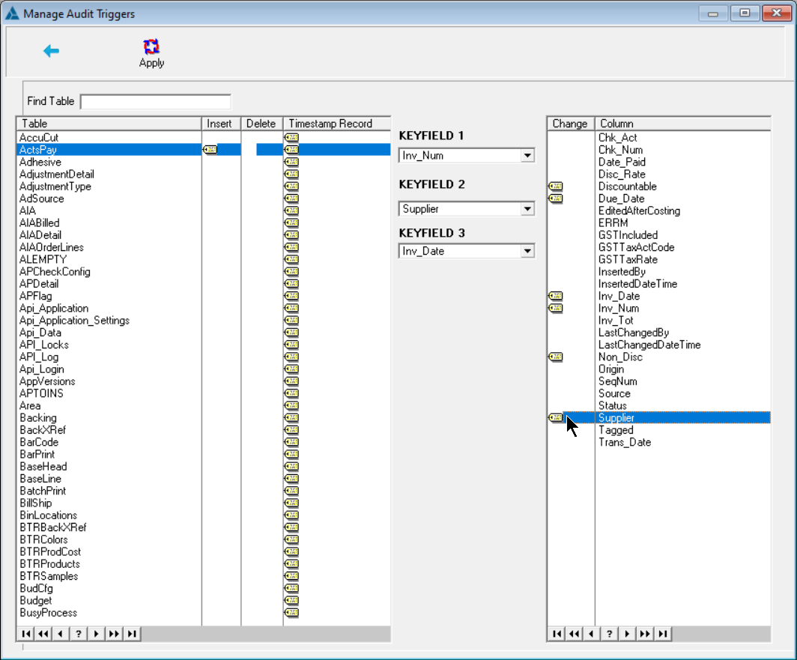
Select Table
Managing audit Triggers

Slide 48
Tag Insert or Delete
Managing audit Triggers

Slide 49
Select
Keyfields
Managing audit Triggers

Slide 50
Tag
Columns
Managing audit Triggers

Slide 51
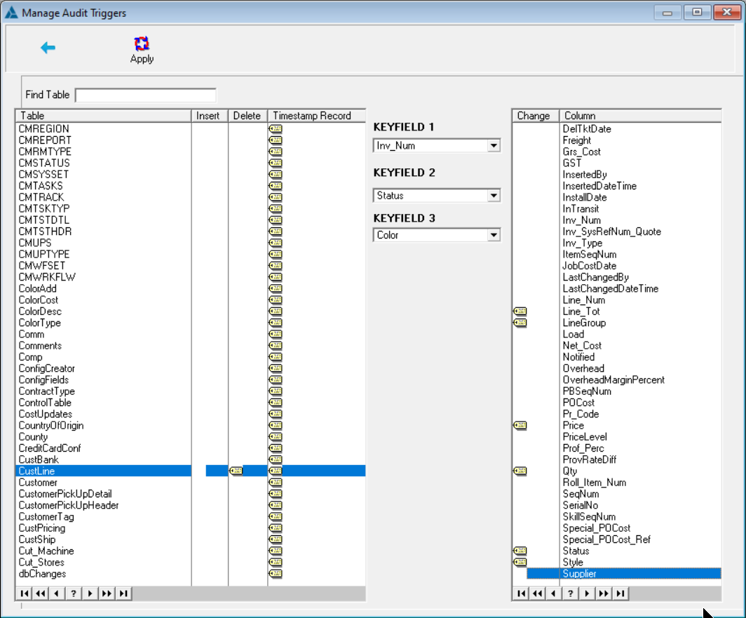
Managing audit Triggers

Slide 52
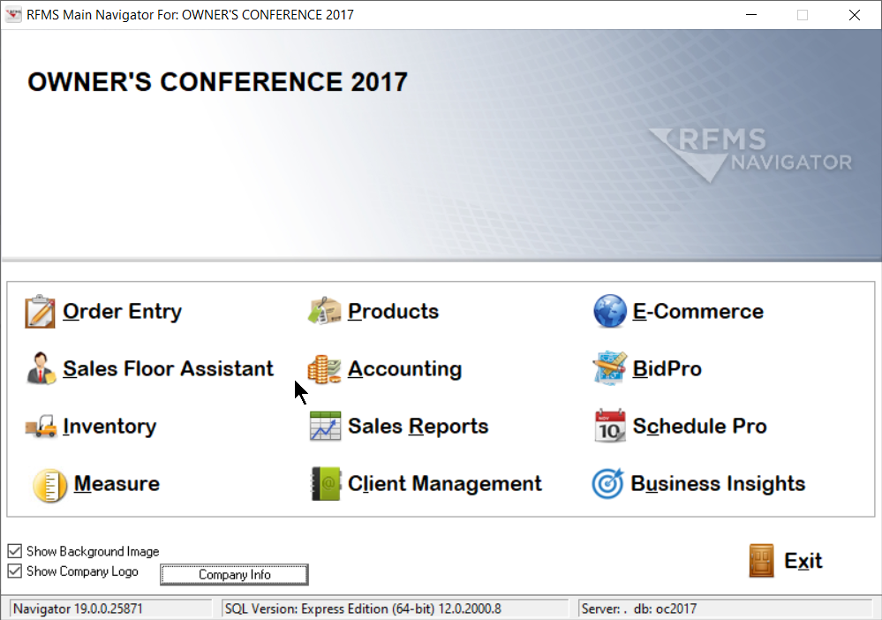
Viewing audit data

Slide 53
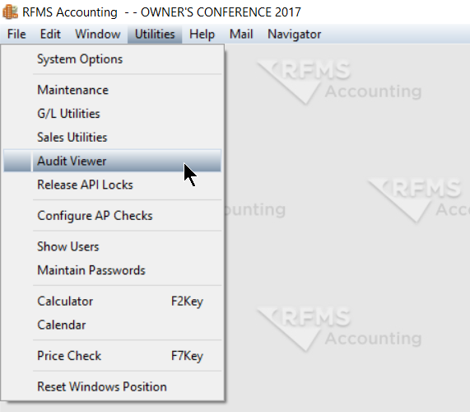
Viewing Audit Data

Slide 54
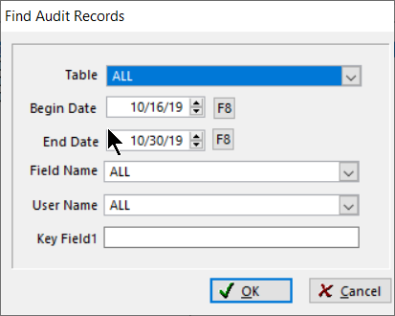
Table to look at selected data table only
Filter to one field in the table
Begin/End Date to filter for date range
Select a user name to search for
Enter data to search from Keyfield
Viewing Audit Data

Slide 55
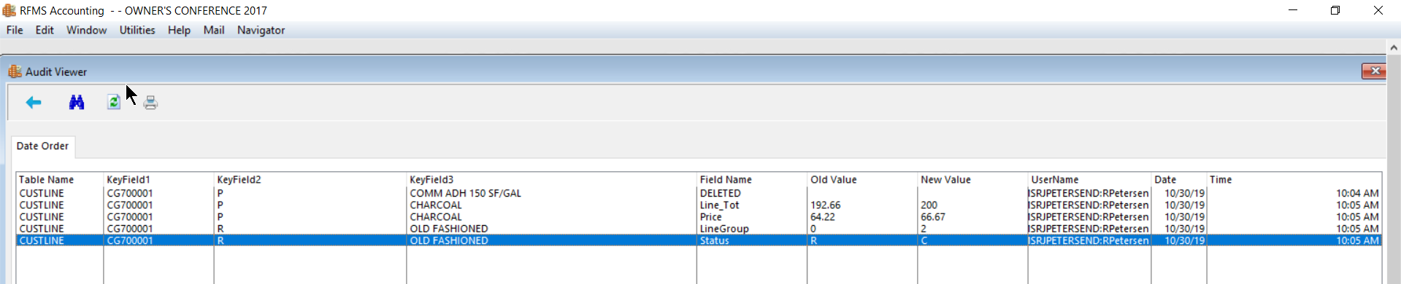
Viewing Audit Data

Slide 56
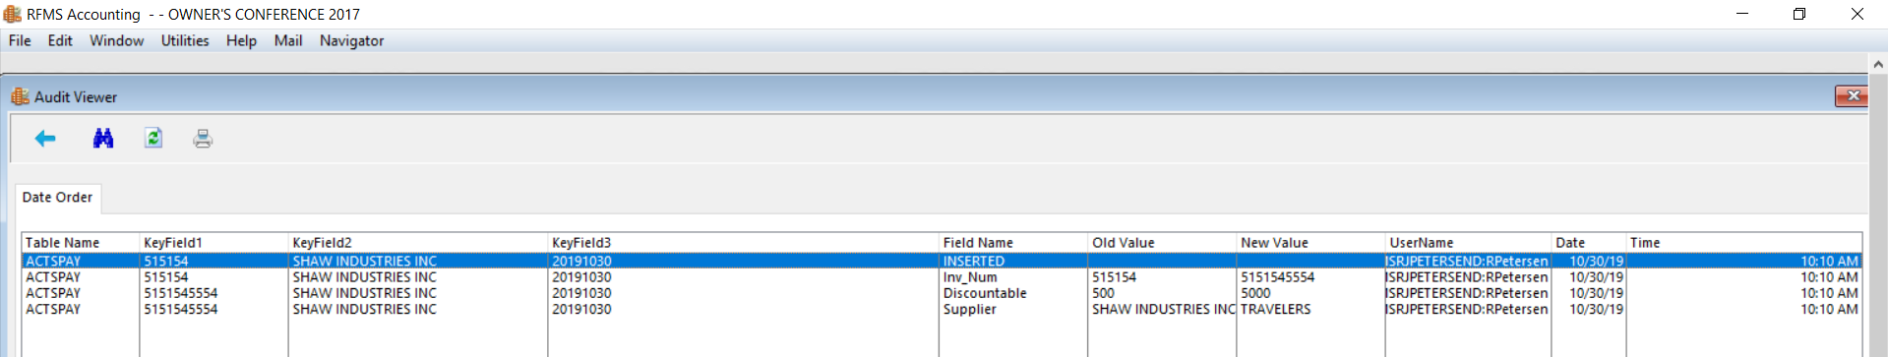
Viewing Audit Data

Slide 57
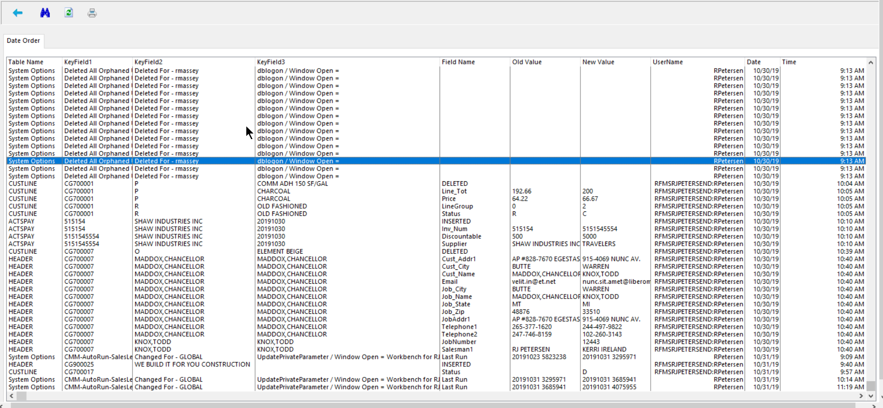
Viewing Audit Data

Slide 58
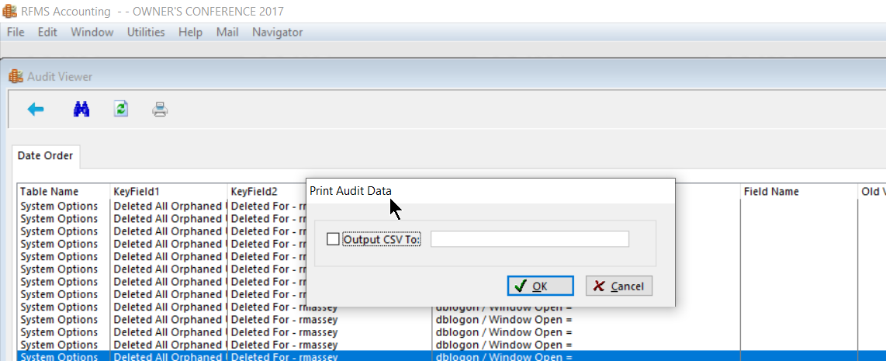
Press Printer
Press OK to print
printing Audit Data

Slide 59
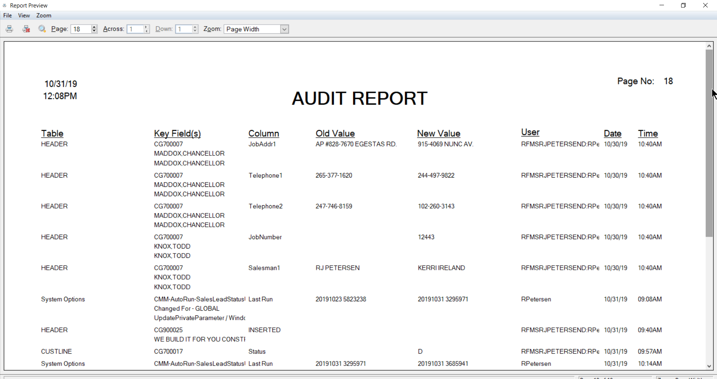

Slide 60

How do I learn more?
https://rfmsinc.zendesk.com/hc/en-us/articles/201885243-Enterprise-Manager-User-Guide
Contact your CSM or Trainer
Purchase of Enterprise Manager includes training and setup on your system

Slide 61

Any Questions?

